Slide 1

Cycle 1
Visualization
Project #3 Team Orange
Cady Pridgeon, Amee Kivette, Keanna Tennyson, Laura Wilson

Slide 2
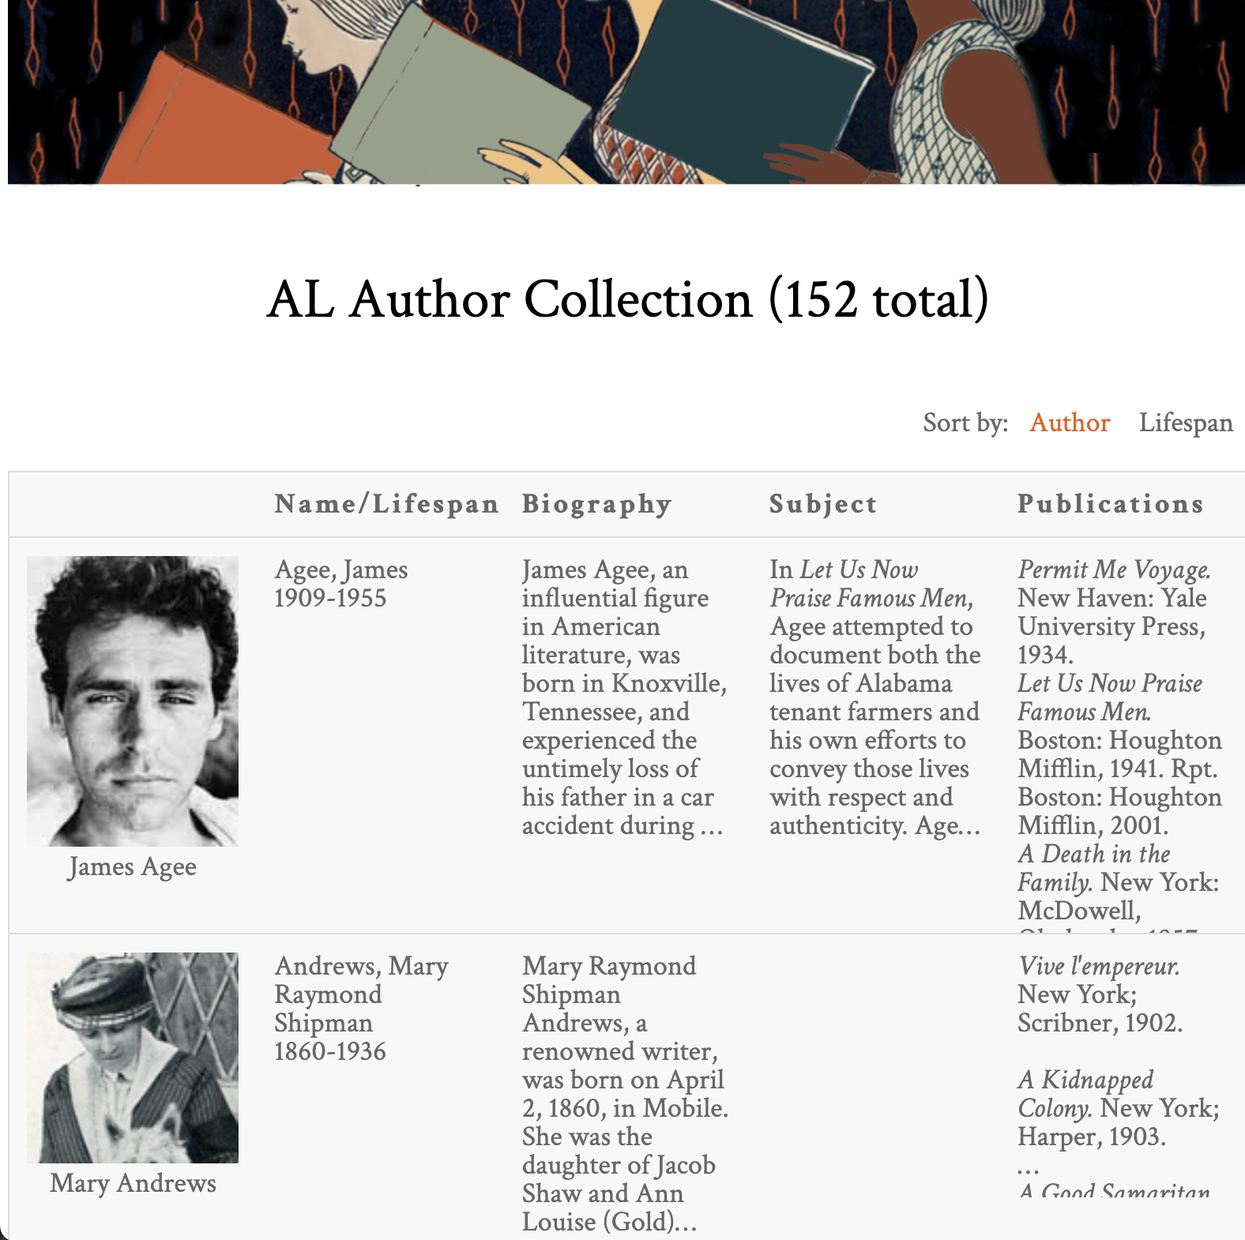
Alabama Authors
Laura Wilson
Introduction
Alabama Authors of the 19th and 20th Centuries
Dr. Beverly Park Rilett
Project Mission
Visualize wealth of data
Author lifespans
Chronology
Encourages data exploration
Valuable for research
Sample of the AL Author Collection from the Alabama Authors website

Slide 3

System Metaphor & Cycle Intent
Laura Wilson
System Metaphor
Museum exhibit
Allows visitors to take a glance before diving in
Cycle Intent
Add all of the Alabama Authors data entries
Over 1700 author entries
Create initial chronology prototypes
Rapidly prototype multiple product options
Person viewing work at an art gallery or exhibit

Slide 4
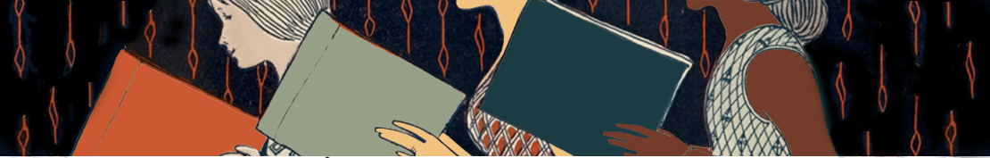
User Stories

Slide 5
1.0 Chronology Data Visualization
Amee Kivette
Summary
As a user, I want to view authors on the Alabama Authors website in a chronology/timeline format to better explore and learn about the authors.
Description
This type of visualization enables users to explore the periods authors were alive and popular in order to facilitate education, understanding, and research of the authors.
Status
In Progress

Slide 6
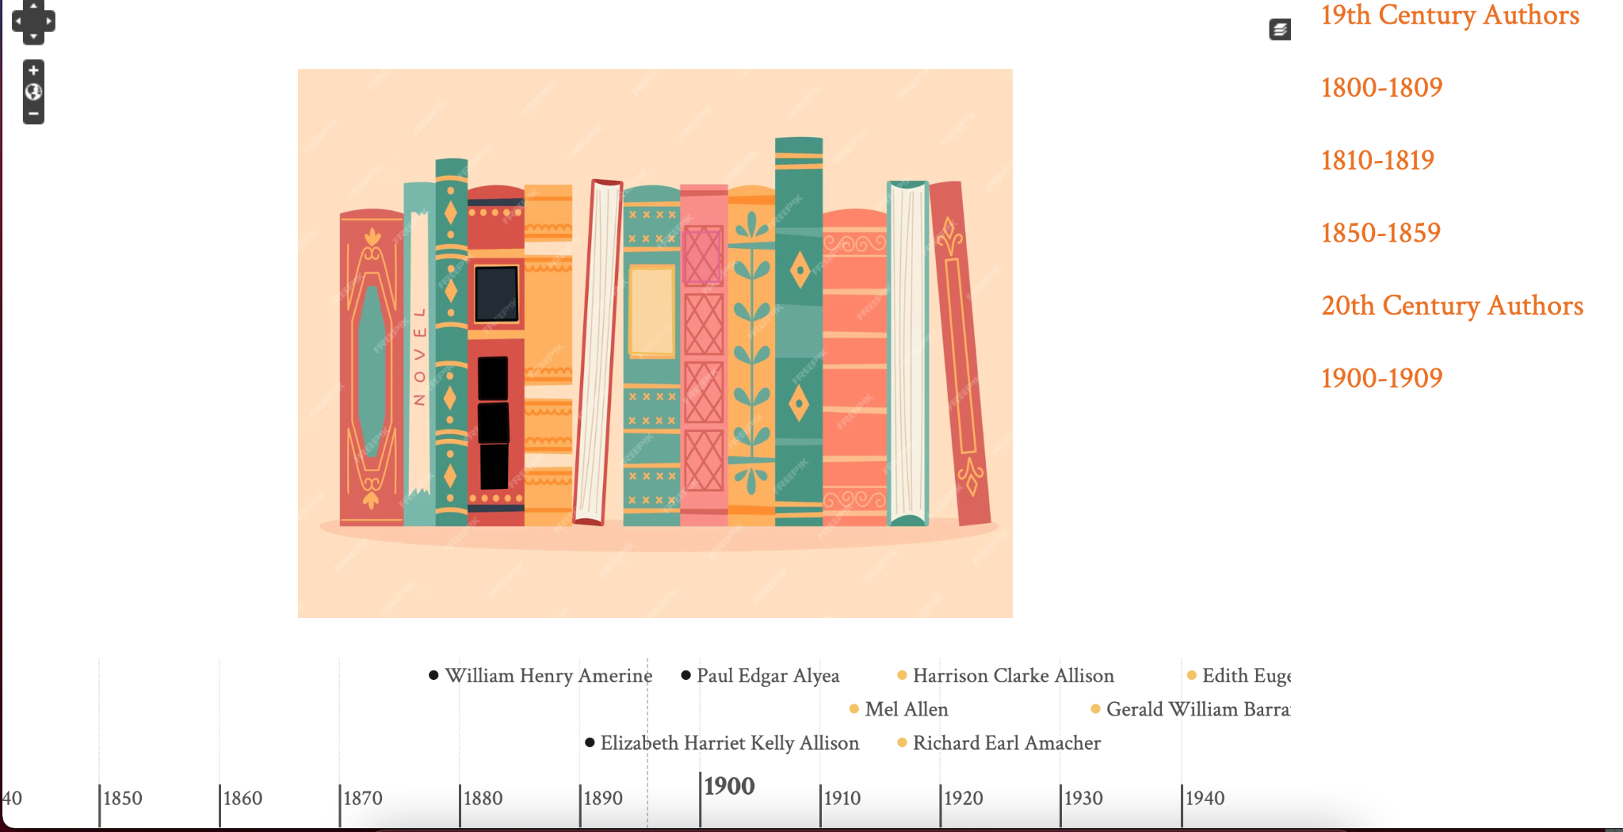
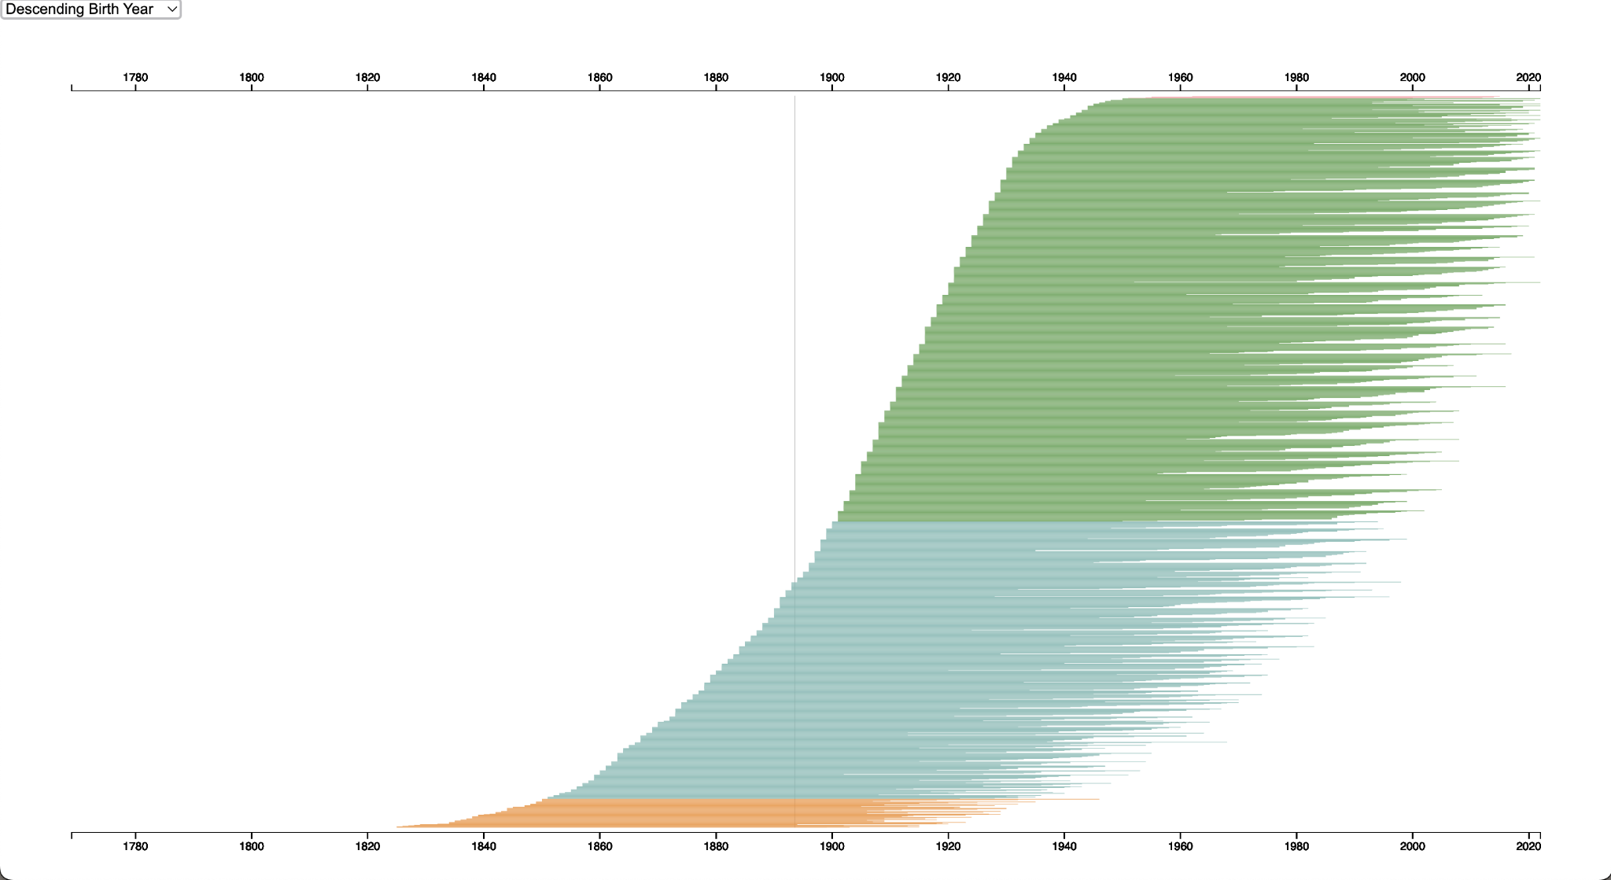
User Story 1.0 Progress
Neatline plugin with SIMILE Timeline widget
D3.js bar chart chronology

Slide 7
1.1 Chronology Data Visualization
Amee Kivette
Summary
As a user, I want to be able to see author names, birth years, death years, and image when I hover over or select nodes in order to quickly learn about the author without having to navigate to their details page.
Description
Allowing users to see important information at a glance on the visualization supports their exploration and search of authors. It also helps to differentiate nodes within the visualization.
Status
In Progress

Slide 8
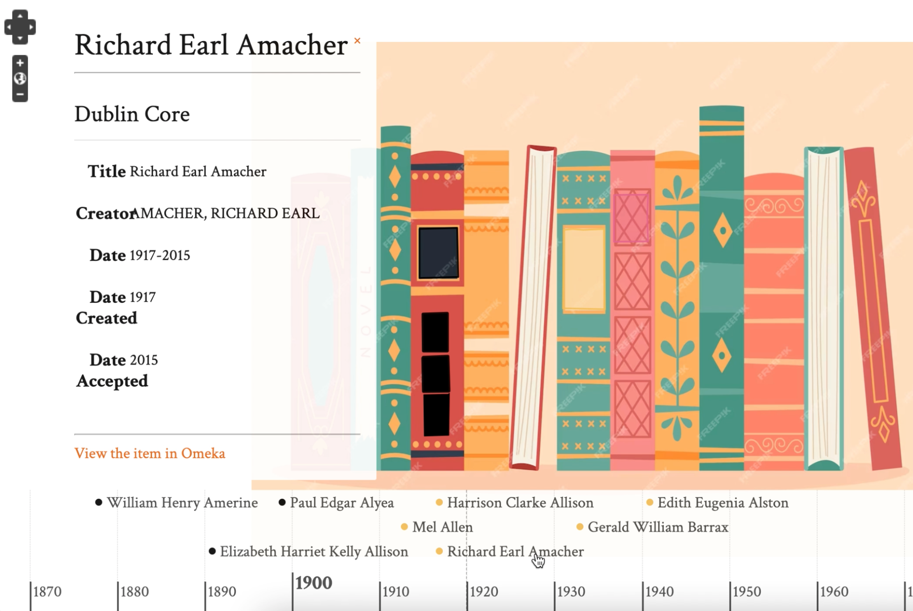
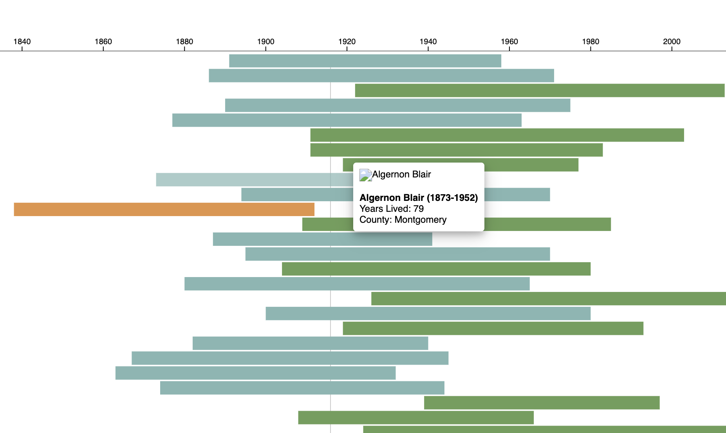
User Story 1.1 Progress
Neatline plugin with SIMILE Timeline widget
D3.js bar chart chronology

Slide 9
1.2 Chronology Data Visualization
Amee Kivette
Summary
As a user, I want to be able to interact with author nodes on the visualization to access their details page, allowing me to quickly learn more about authors directly from the chronology.
Description
There are detailed pages for each author in the database, so it would support research and education about authors by permitting users to access these informative pages straight from a visualization.
Status
In Progress

Slide 10
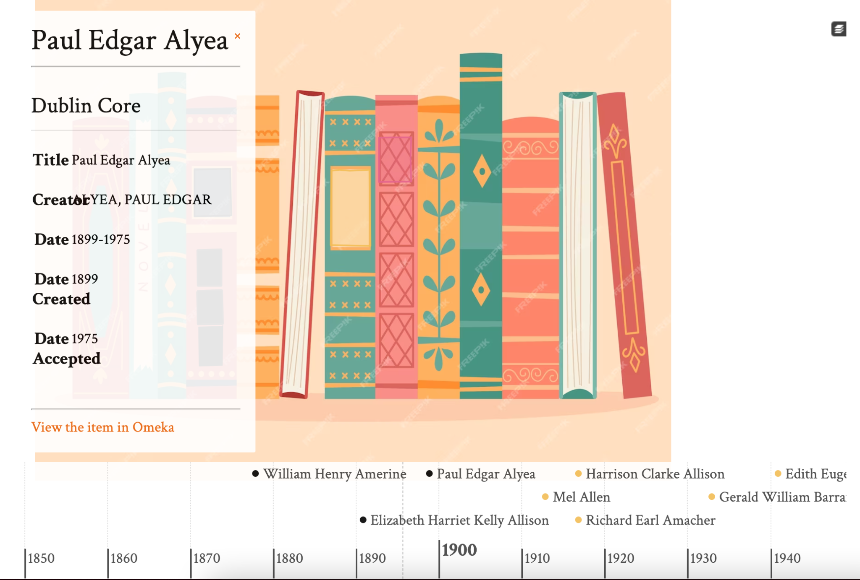
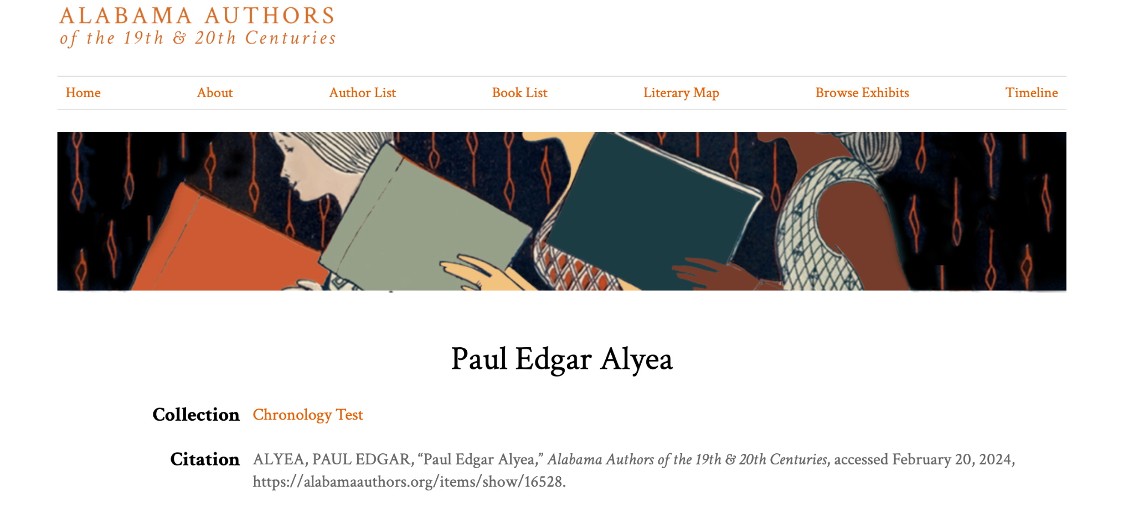
User Story 1.2 Progress
Author details page on Alabama Authors website
Neatline plugin with SIMILE Timeline widget

Slide 11
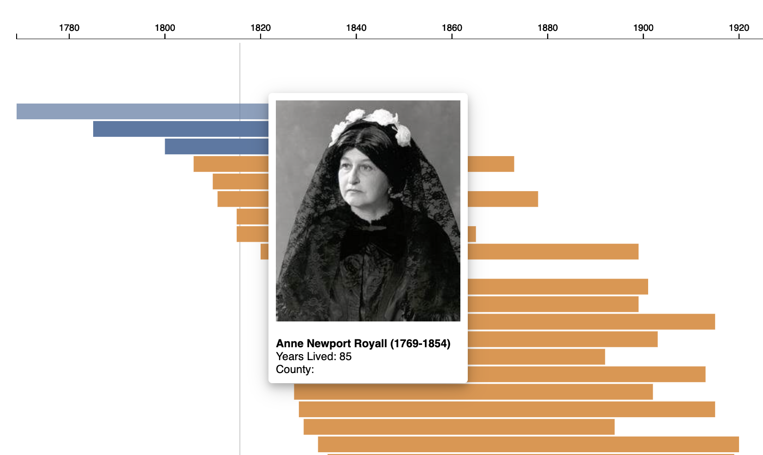
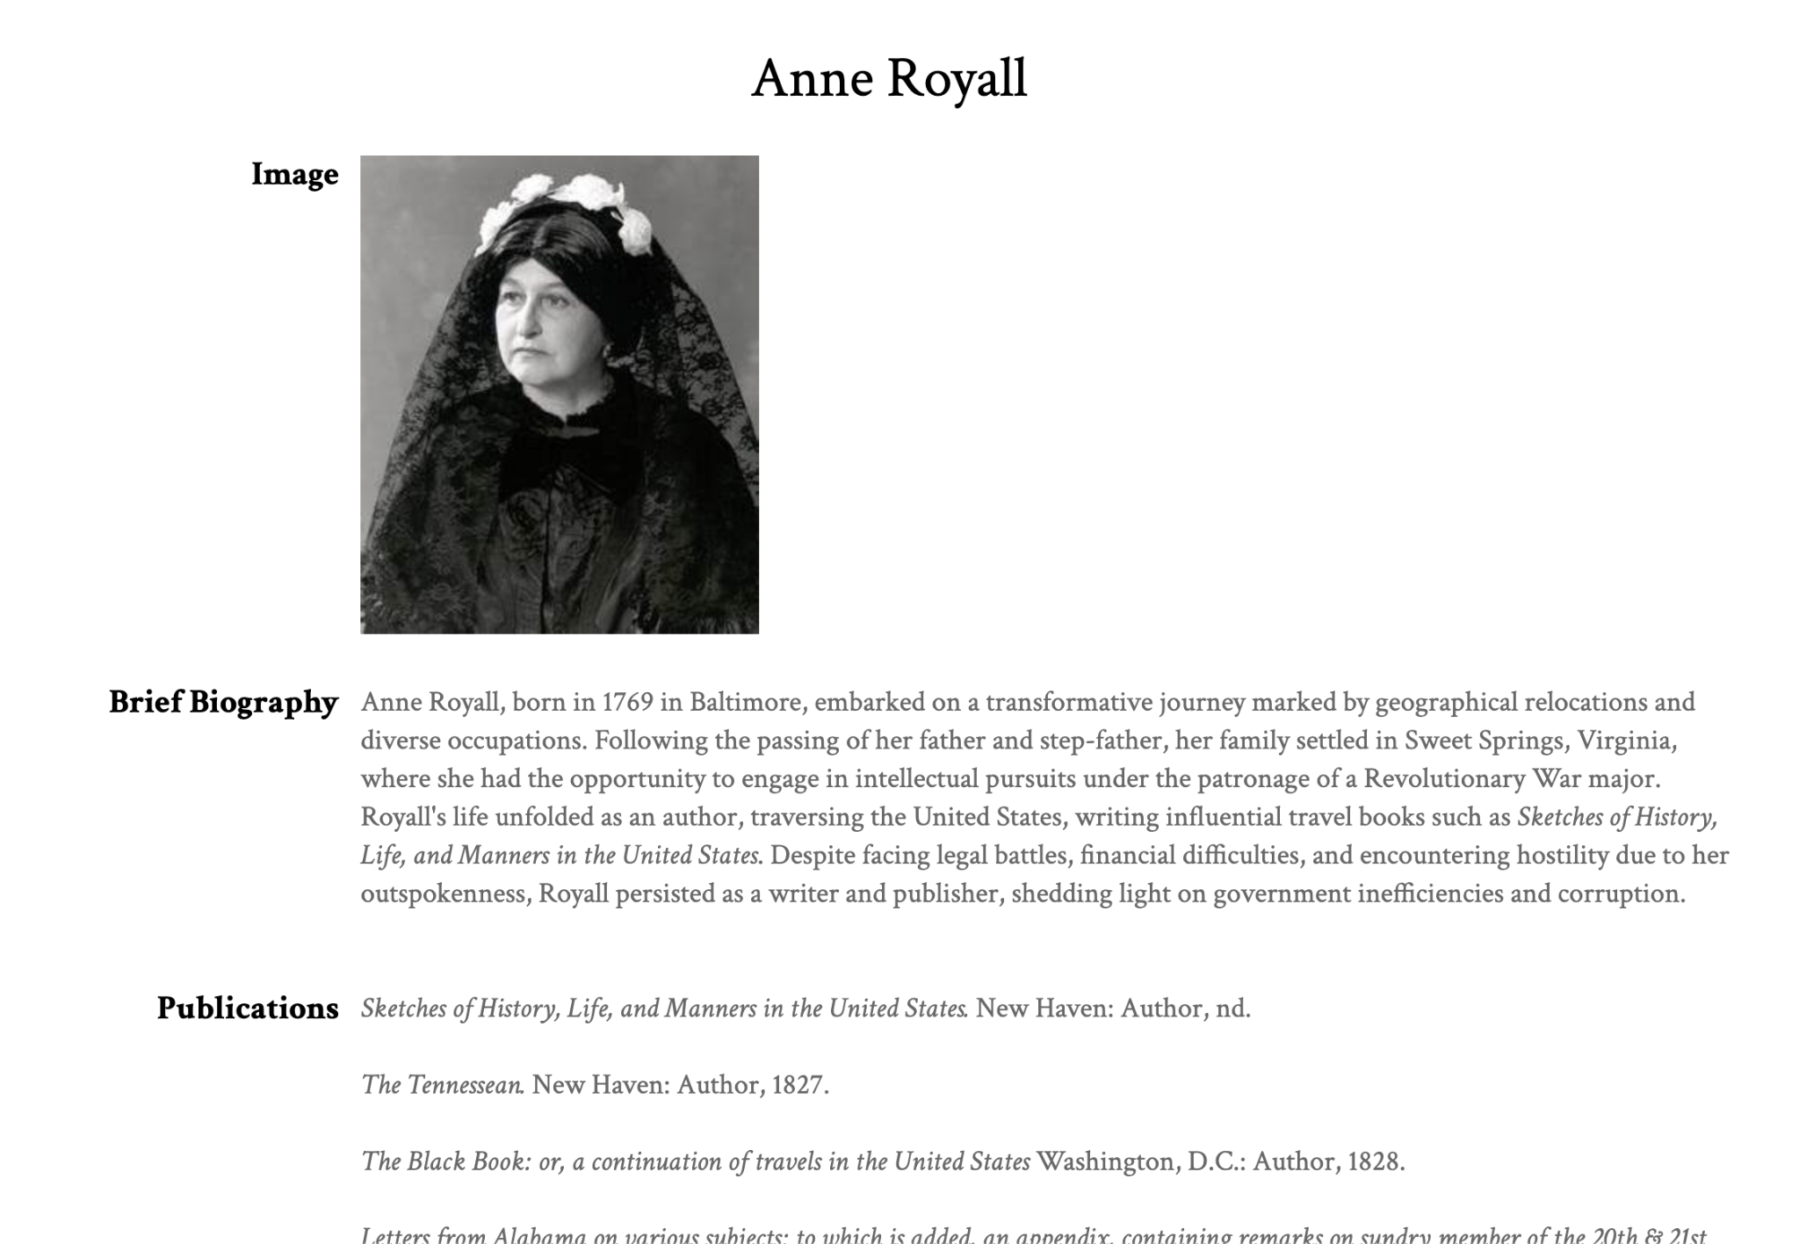
User Story 1.2 Progress
Author details page on Alabama Authors website
D3.js bar chart chronology

Slide 12
1.3 Chronology Data Visualization
Cady Pridgeon
Summary
As a user, I want to be able to filter the visualization based on criteria, such as birth year or author name, in order to customize my exploration of relevant information.
Description
Including filtering functionality better equips users for efficient data exploration. Without it, users may feel frustrated or experience cognitive overload if they are unable to access information of interest quickly and effectively.
Status
In Progress

Slide 13
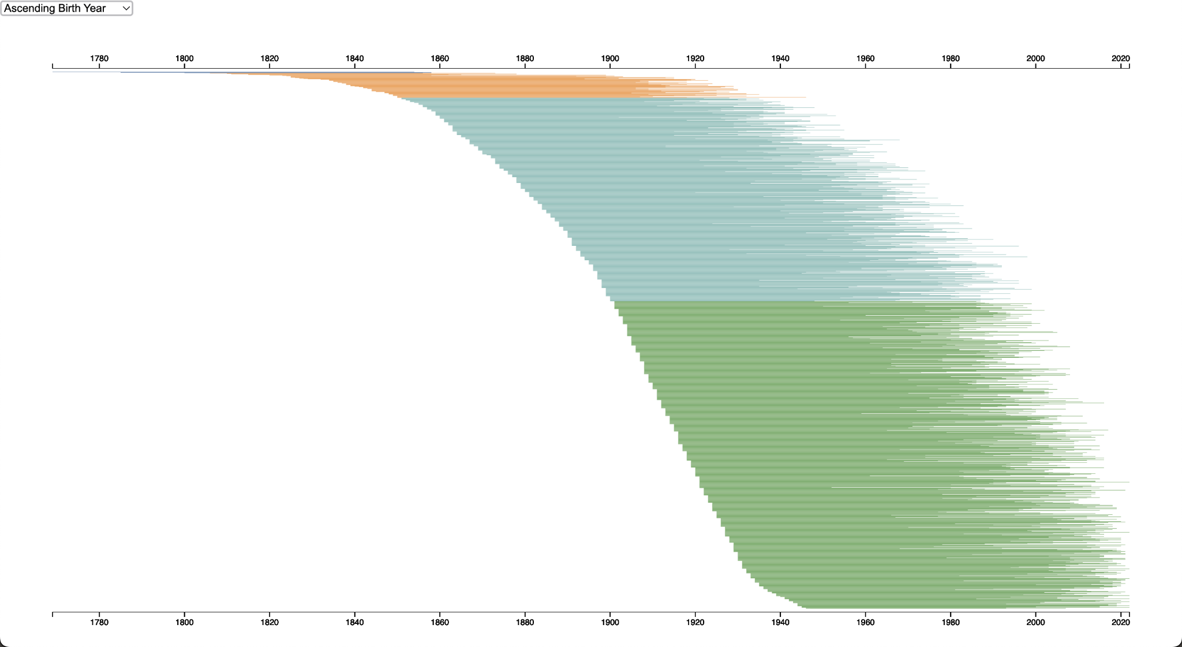
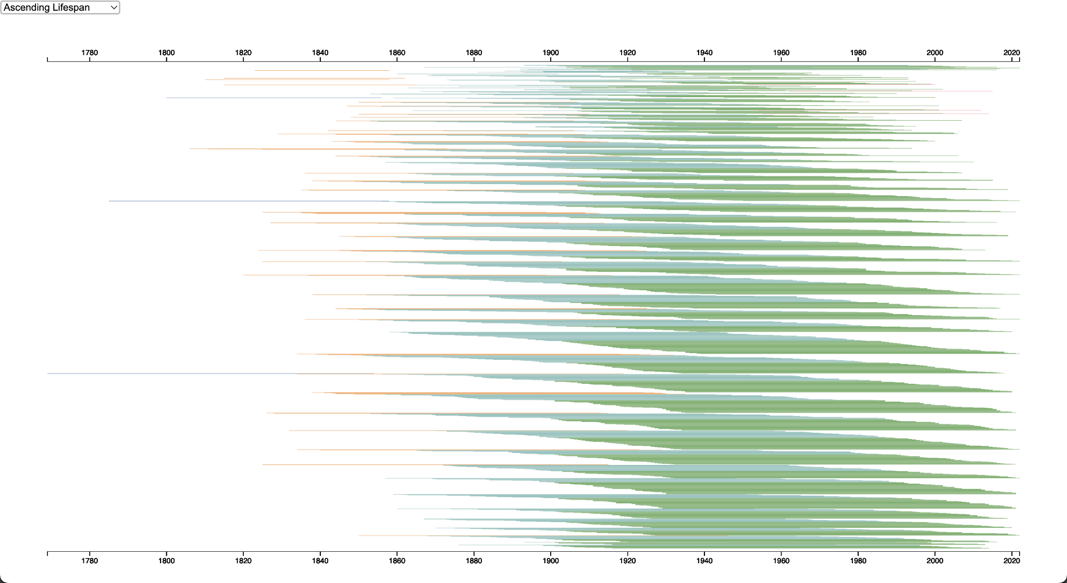
User Story 1.3 Progress
D3.js bar chart chronology sorted by ascending birth year
D3.js bar chart chronology by ascending lifespan

Slide 14
1.4 Chronology Data Visualization
Cady Pridgeon
Summary
As a user, I want to be able to export my visualization to keep for my records to conduct research or simply save my findings.
Description
Being able to quickly export a complex visualization into an image or PDF supports users in research and grants them a way to save progress after utilizing visualizations on the website.
Status
Not Started

Slide 15
1.5 Chronology Data Visualization
Cady Pridgeon
Summary
As a user, I want to view all of the Alabama authors from the 19th and 20th century to gain a complete picture of the literary landscape from this area and time.
Description
Currently, the website includes 150 authors in its literary map visualization and detail pages. However, there are around 1,500 data entries for authors from this time, so it is important to include these additional data points for completeness.
Status
Completed

Slide 16
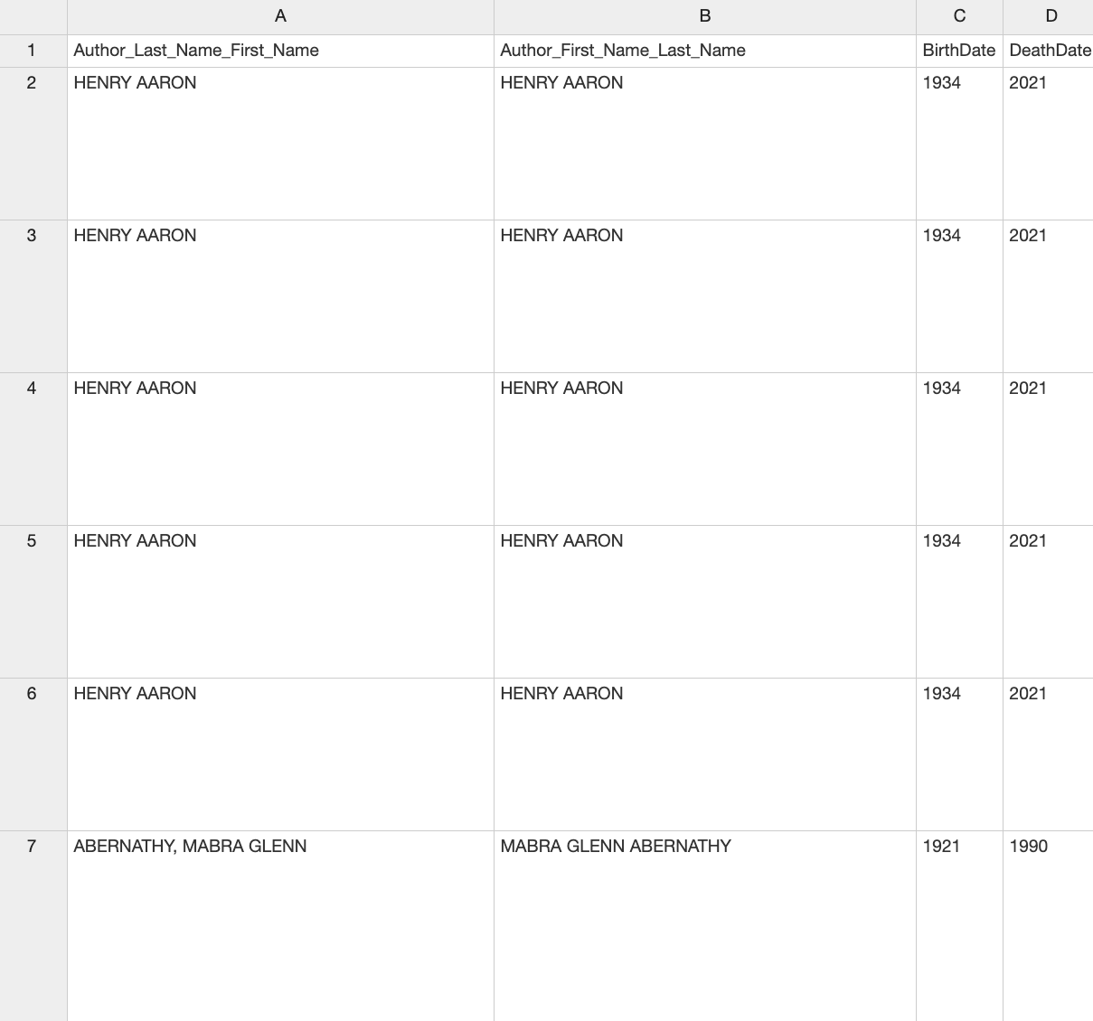
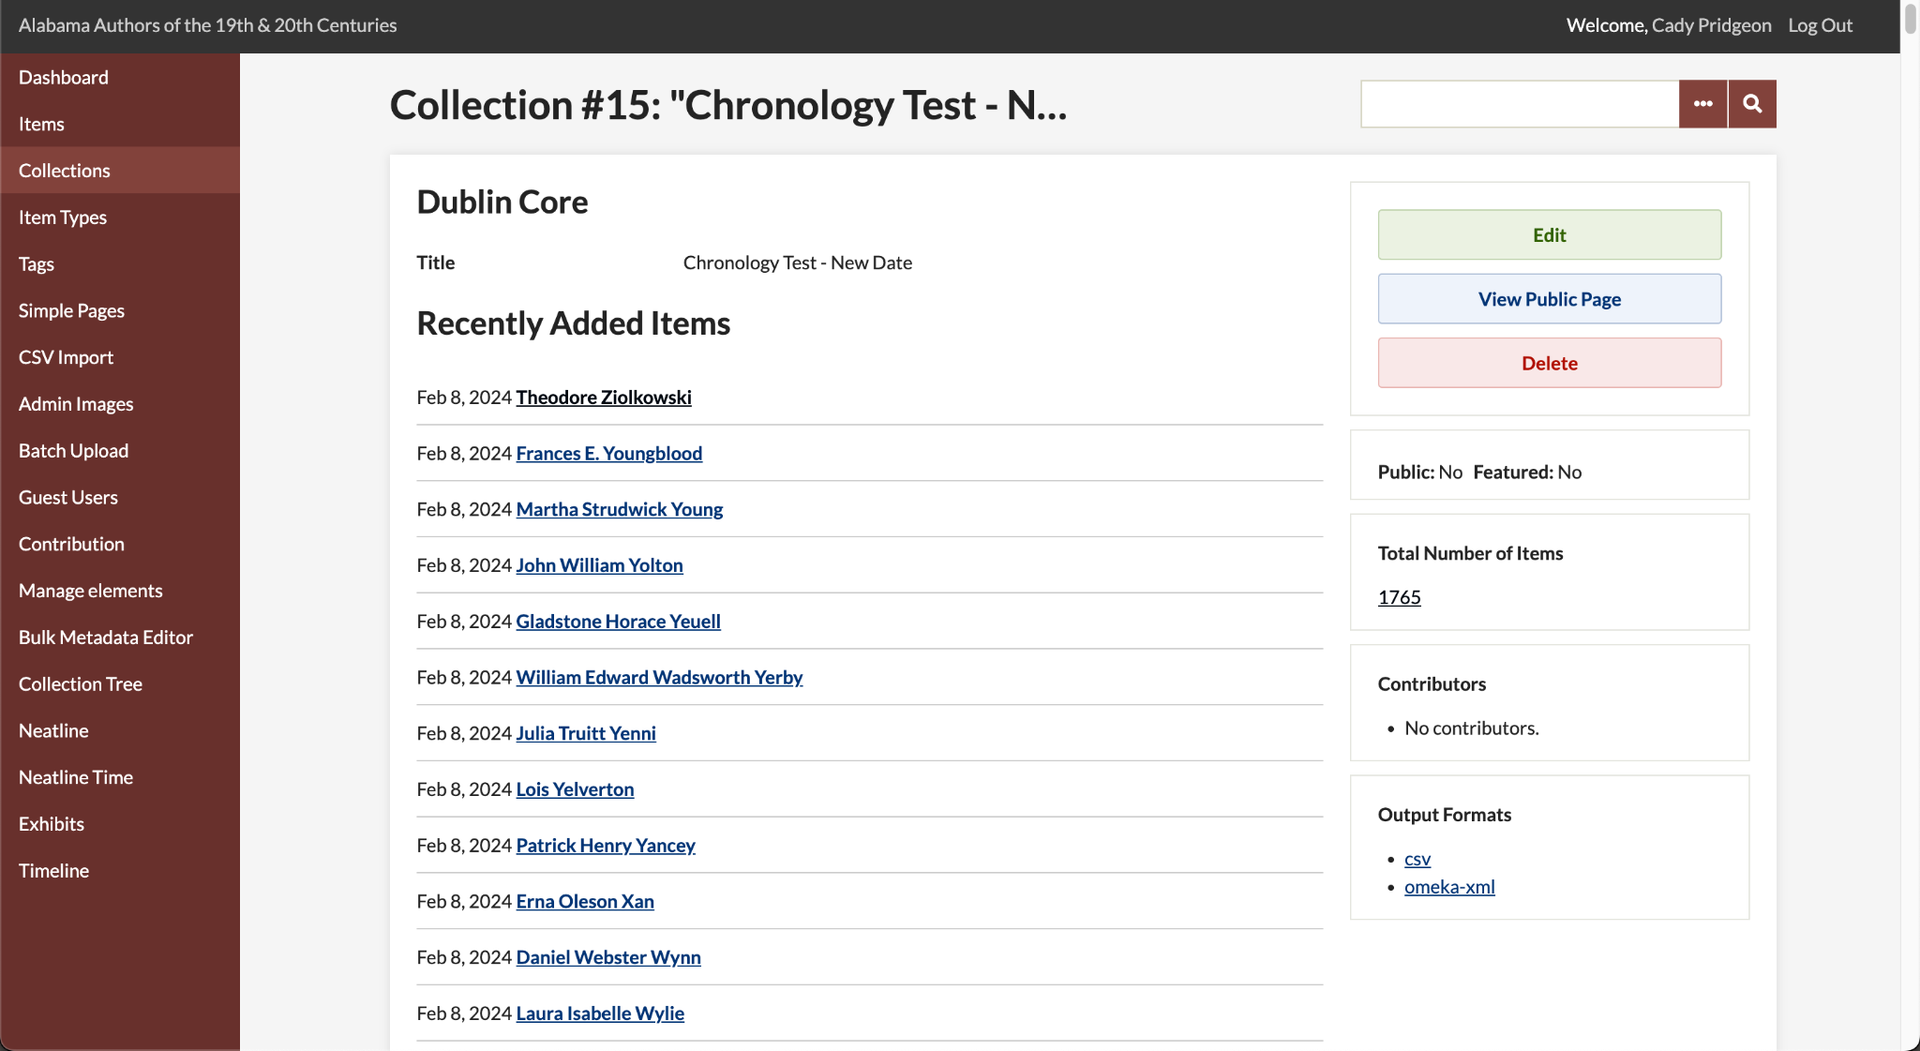
User Story 1.5 Progress
Alabama Authors data entries
Alabama Authors data in Omeka Classic

Slide 17
1.6 Chronology Data Visualization
Cady Pridgeon
Summary
As a user, I want to be able to access the Alabama Authors website from any device, such as a computer, tablet, or phone, and experience an accessible data visualization.
Description
The data visualization should be responsive, supporting users from any device, including a mobile phone.
Status
Not Started

Slide 18
1.7 Chronology Data Visualization
Cady Pridgeon
Summary
As a user, I want to experience an accessible user interface on the Alabama Authors website to ensure my abilities do not interfere with viable interactions on the website.
Description
Color contrast, tab index, and verbiage are a few aspects that make an interface accessible and inclusive. It is crucial that anyone, regardless of their abilities, should be able to access and navigate the website and visualizations with ease.
Status
Not Started

Slide 19
1.8 Chronology Data Visualization
Amee Kivette
Summary
As an administrator, I want to be able to manage the chronology/timeline data visualization with Omeka Classic to avoid issues with GitHub repository connections.
Description
Sometimes data visualizations are connected to the digital humanities websites by hosting the visualization on a GitHub repository and displaying the result on the website with an iframe. To prevent frustrations associated with this, we must create our visualization using plugins supported by Omeka Classic.
Status
In Progress

Slide 20
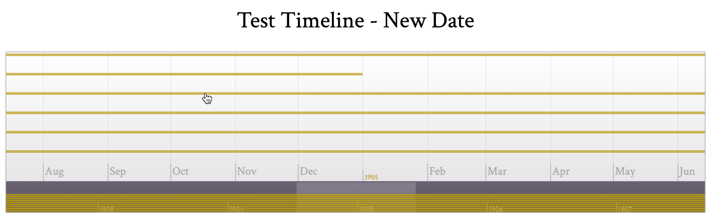
User Story 1.8 Progress
Neatline Time plugin

Slide 21
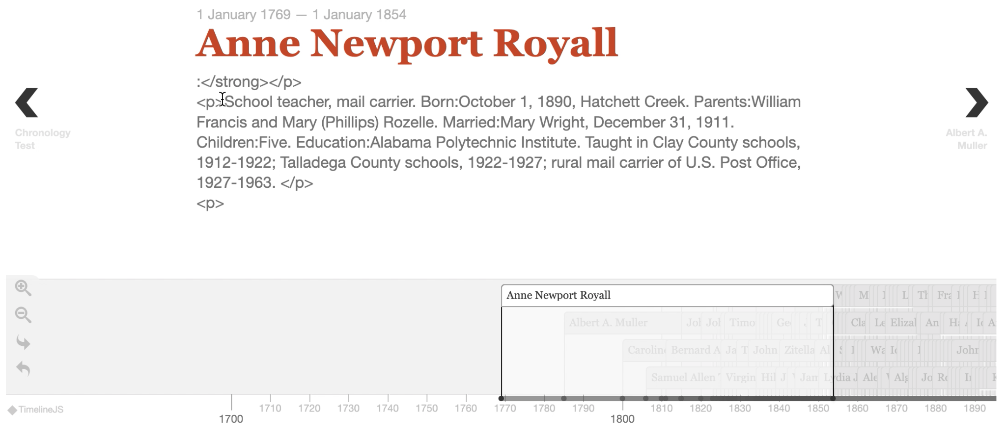
User Story 1.8 Progress
Timeline plugin

Slide 22
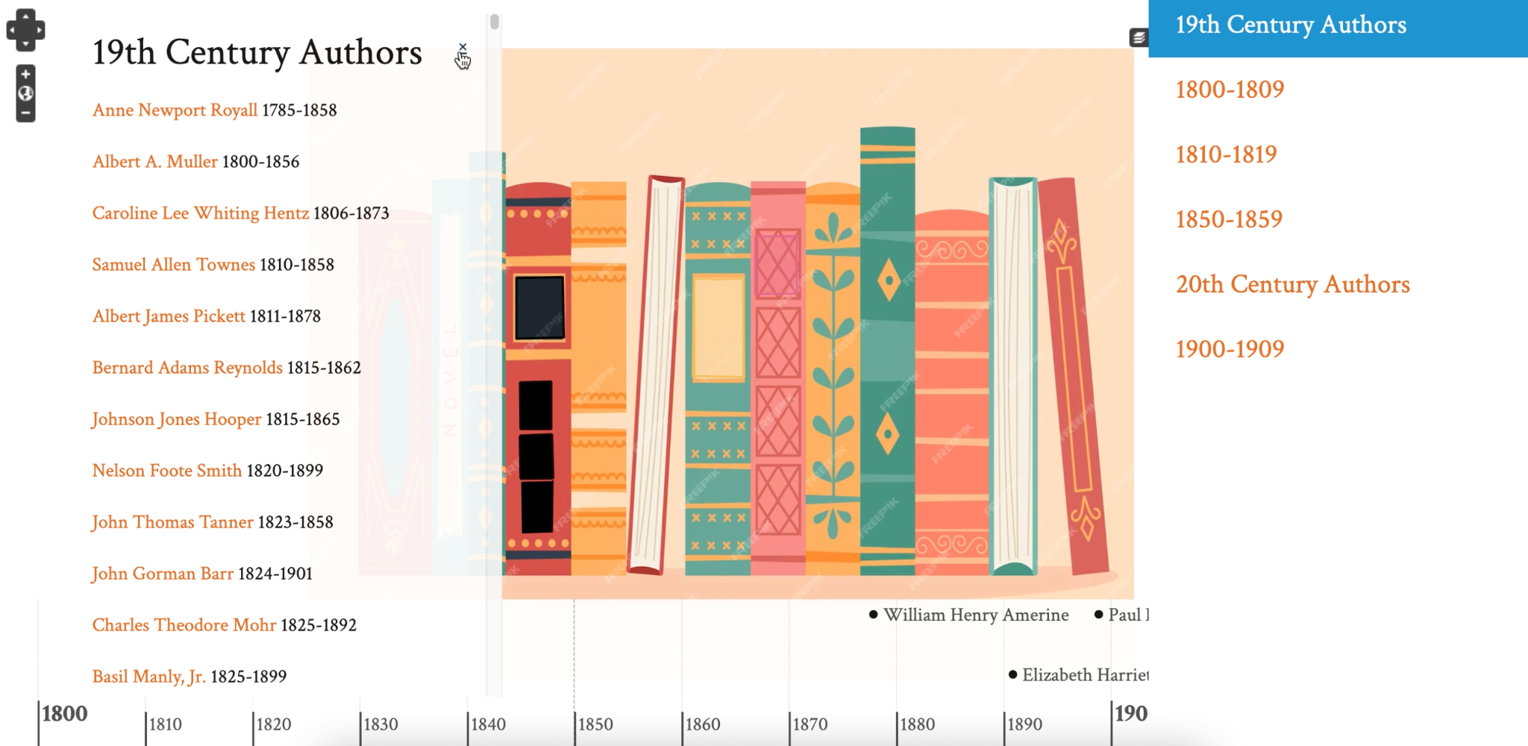
User Story 1.8 Progress
Neatline plugin with SIMILE Timeline widget

Slide 23
2.0 Author Details Page
Cady Pridgeon
Summary
As a user, I want to view an author's date of birth and date of death on their details page to quickly remember the period they lived through.
Description
While users can view an author's date of birth on data visualizations, their birth date and death date are missing from their detail page. This could frustrate users by creating an inconsistency in data availability over various pages on the site.
Status
Not Started

Slide 24
3.0 Sunburst Data Visualization
Amee Kivette
Summary
As a user, I want to view authors on the Alabama Authors website in a zoomable sunburst format to better interact with and explore the authors.
Description
A sunburst-style visualization would enable users to drill down specific periods to identify and analyze authors by period. This would facilitate the education, understanding, and research of the authors.
Status
In Progress

Slide 25
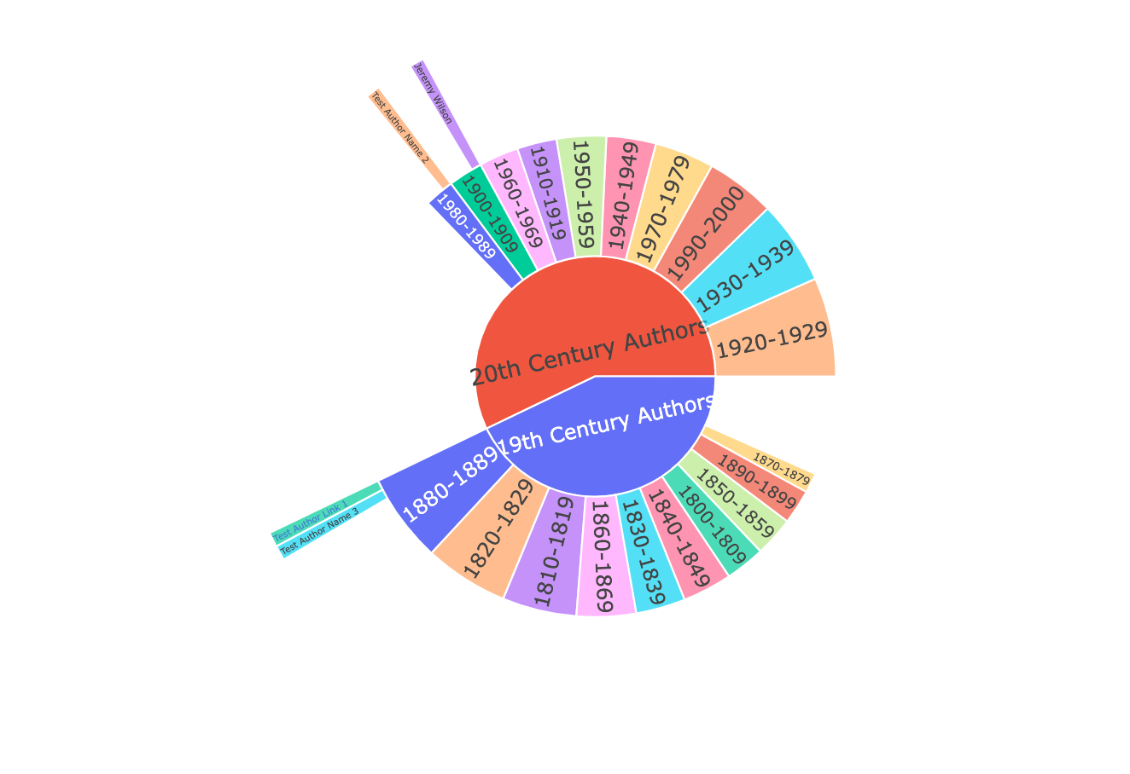
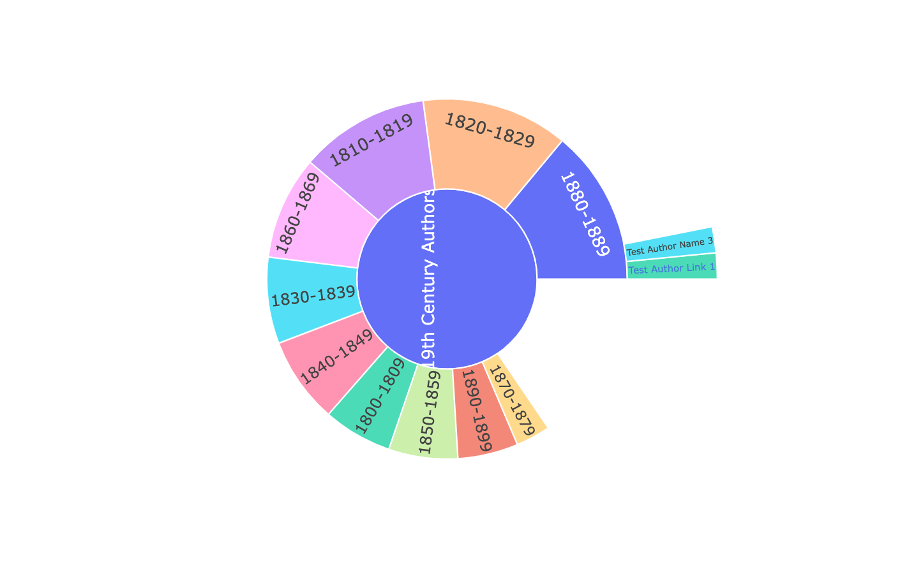
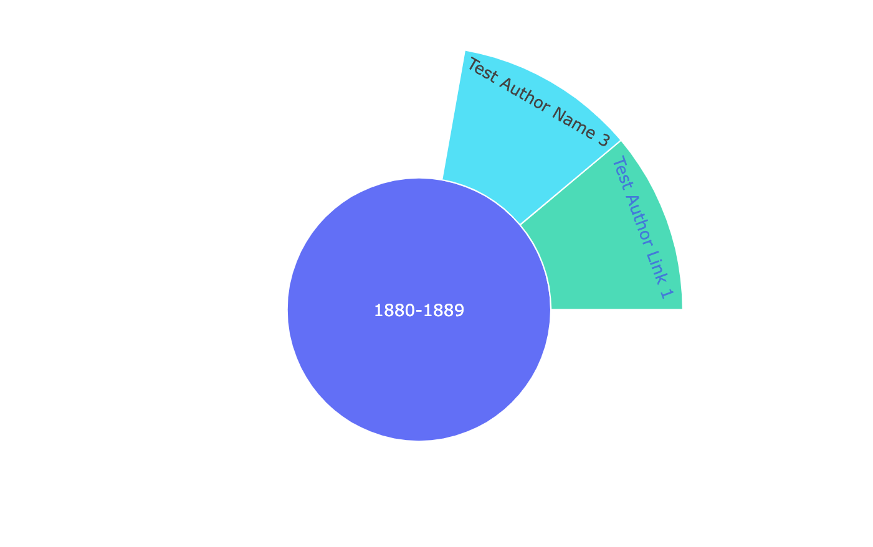
User Story 3.0 Progress
Plotly sunburst data visualization

Slide 26
4.0 Birth Date Data
Cady Pridgeon
Summary
As a user, I want to view an author's birth and death dates instead of birth and death years on visualizations to get a complete picture of the author's information.
Description
Only the author's birth and death years are collected and stored in the data. However, birth dates could potentially be scraped from descriptions to generate a more complete profile for each author.
Status
Not Started

Slide 27
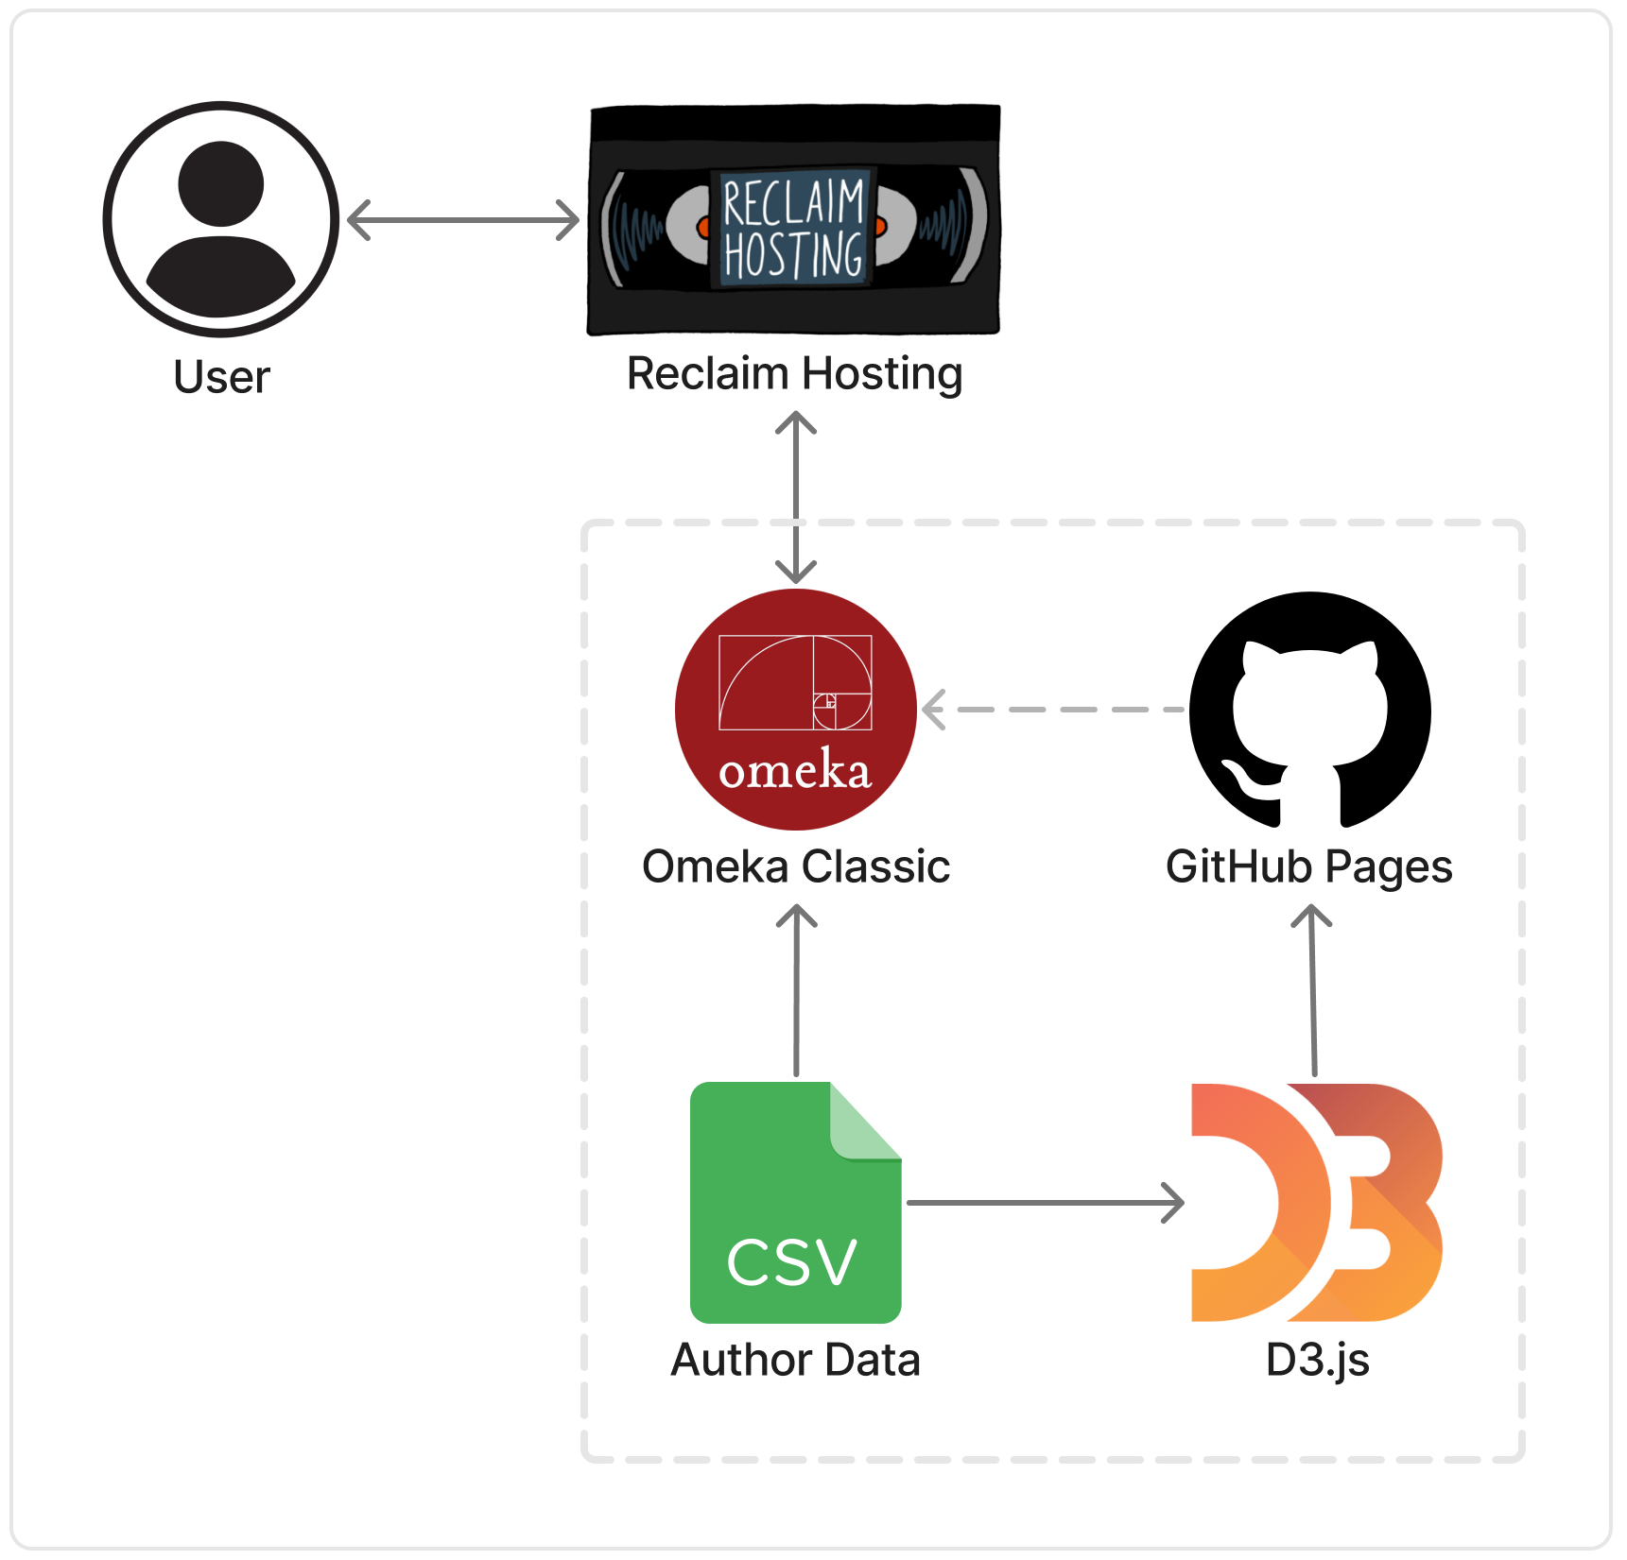
Design
Cady Pridgeon
Architecture
Reclaim Hosting
Omeka Classic
Author Data
CSV file
Experimental
GitHub Pages
D3.js
Architecture diagram, technology flow chart

Slide 28
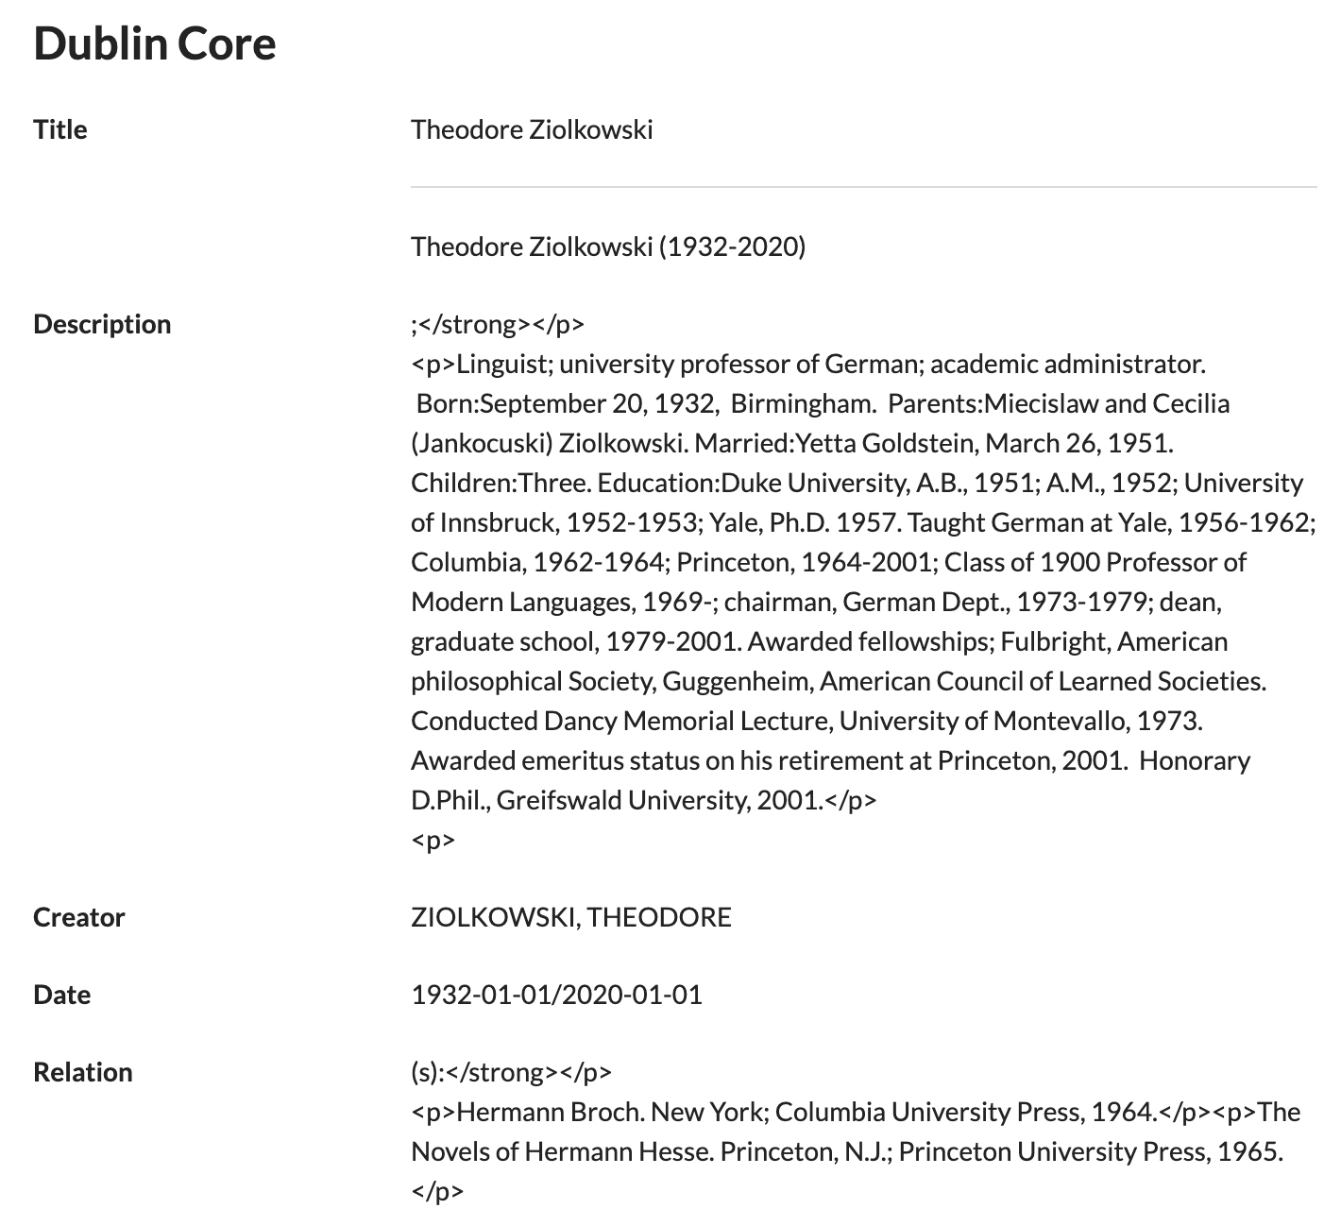
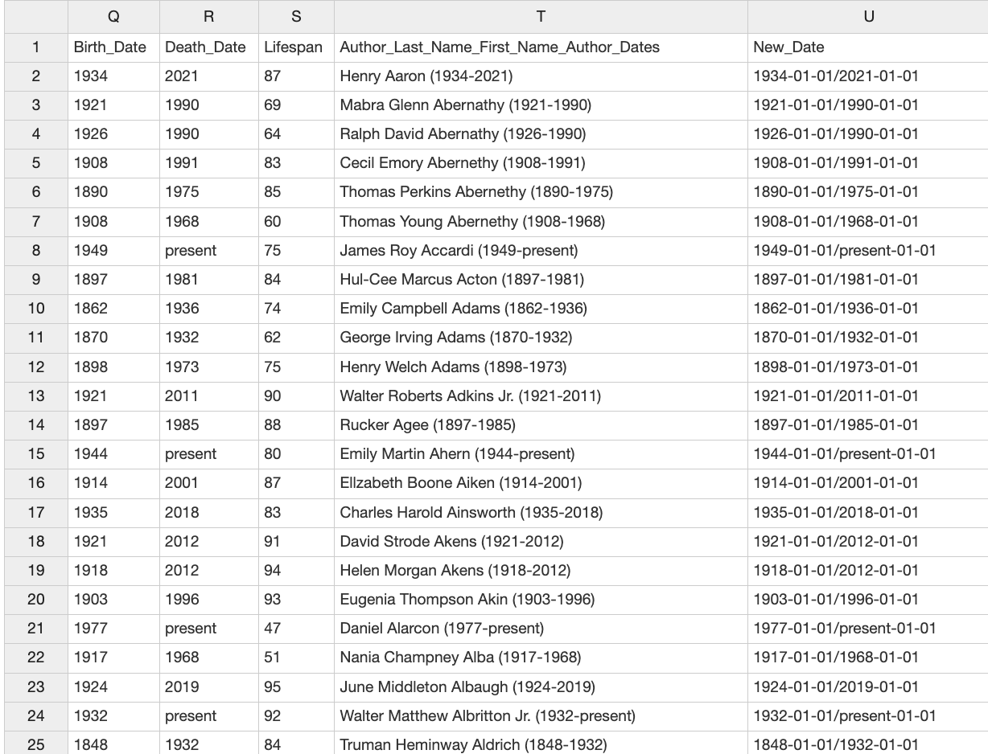
Design
Updated author data CSV
Dublin Core metadata fields on Omeka Classic

Slide 29
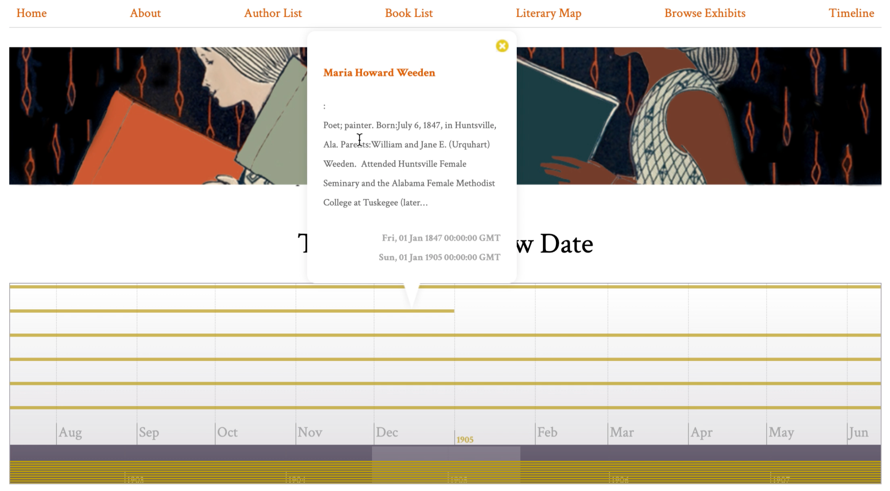
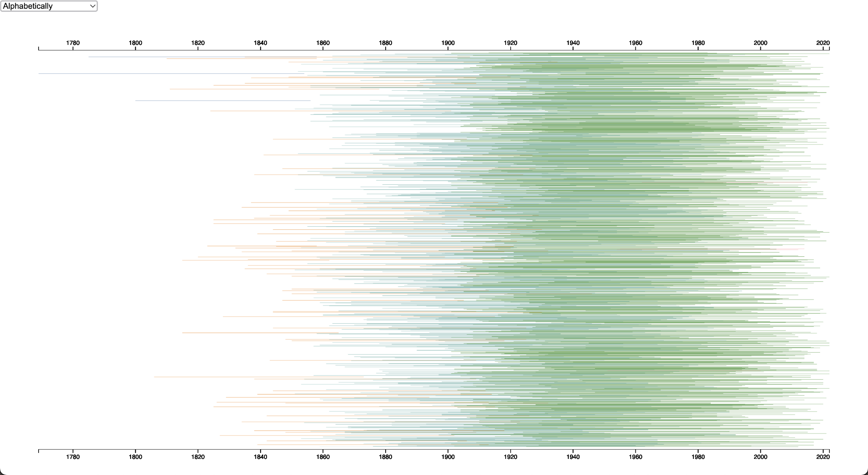
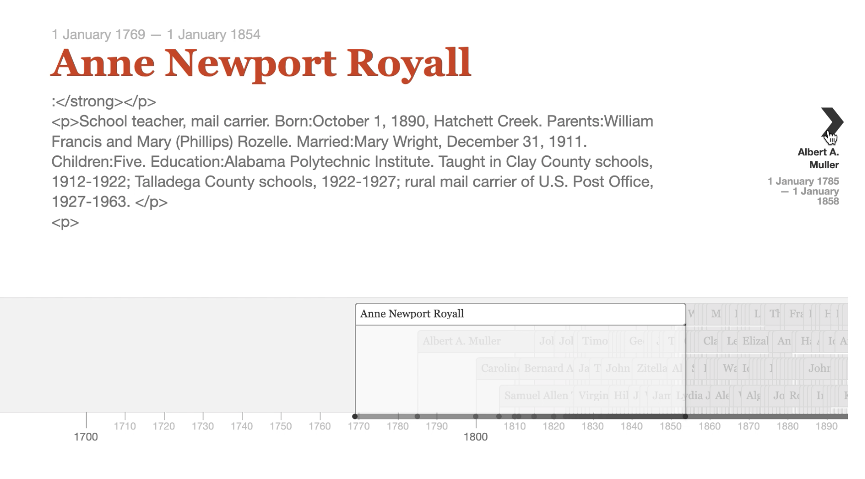
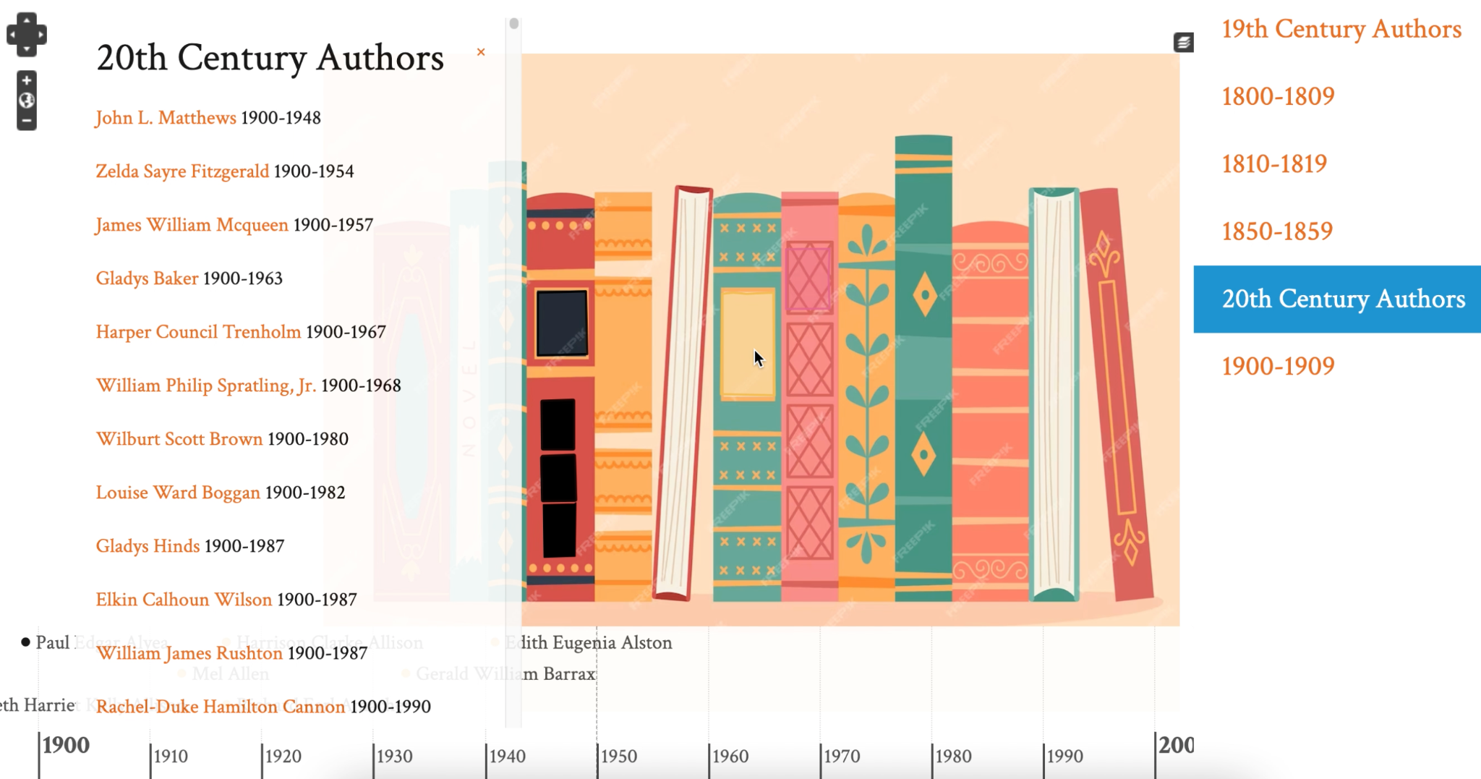
Design
D3.js bar chart chronology visualization
Omeka Classic chronology plugins

Slide 30
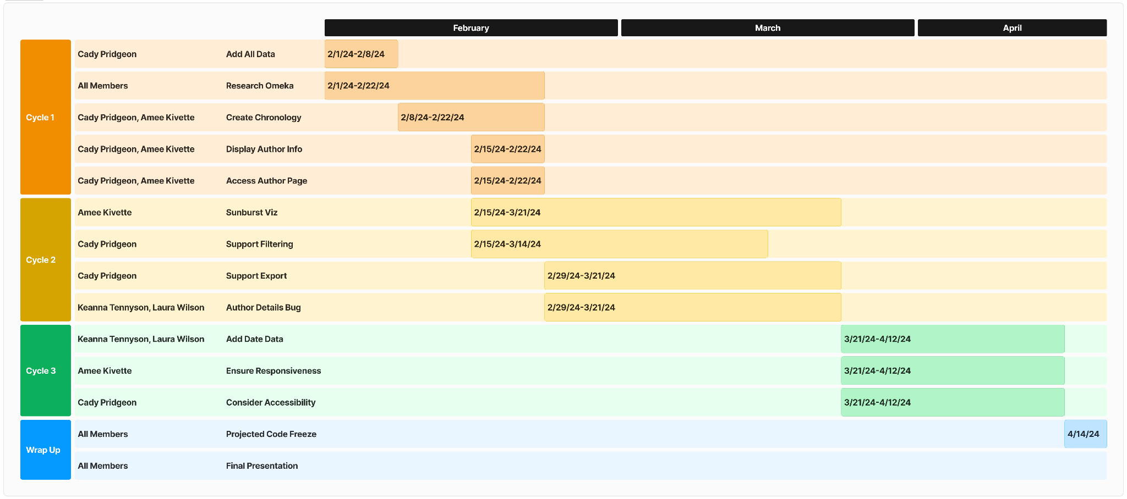
Process
Cady Pridgeon
Sponsor Communication
Weekly in-person meetings
Open email communication
Project web developer for technical questions
Team Communication
Weekly team check-ins
Text message for general purposes
Zoom for meetings
Gantt chart with estimated development schedule
User Story, Task, & Issue Management
Assignments split between members
Tasks created on a Kanban board in Notion
Problems are discussed with the team

Slide 31



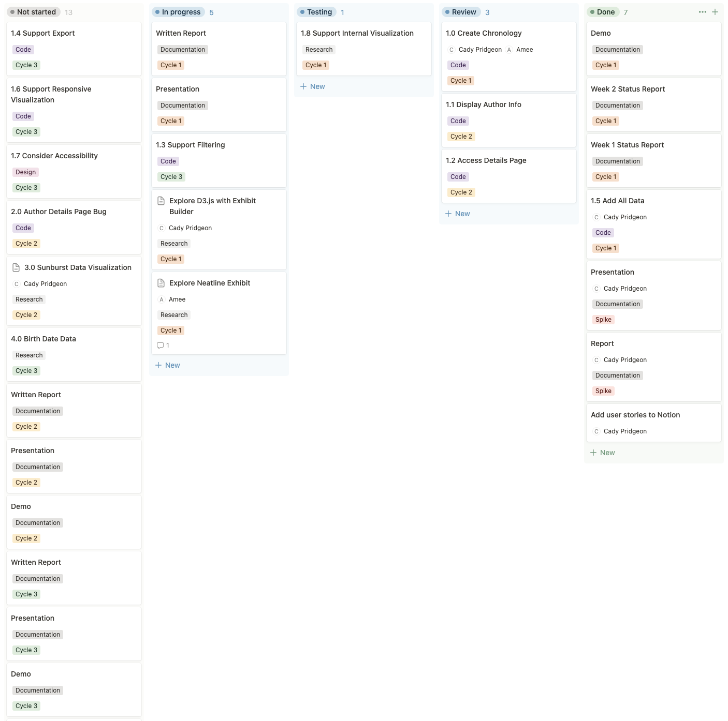
Process
Kanban Board on Notion for team task management

Slide 32

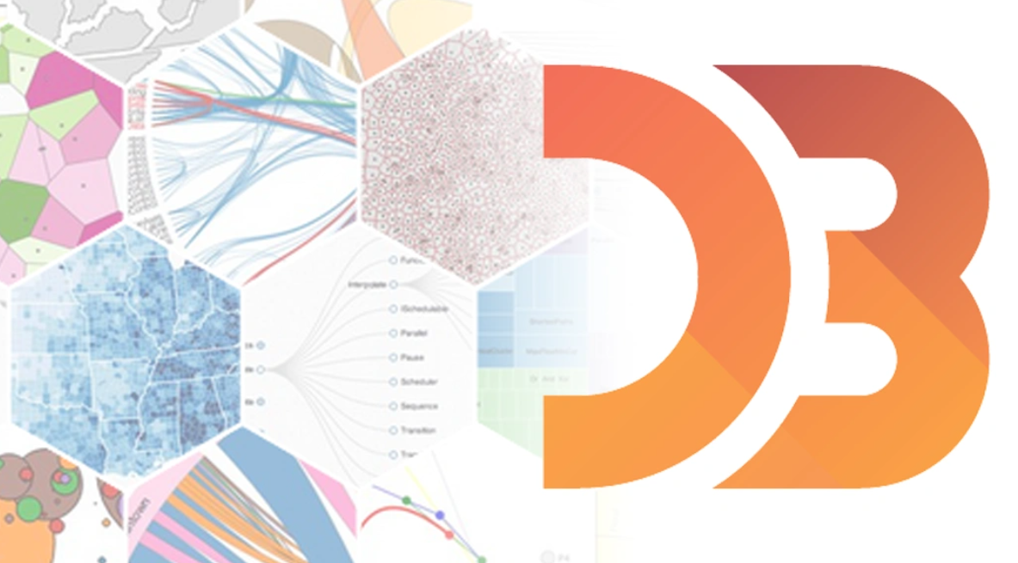

Lessons Learned
Amee Kivette
Creating prototypes of multiple potential solutions:
Allows deeper exploration before committing to a solution
Ensures the solution is a good fit for the project requirements
Creates a strong foundation for future work

Slide 33
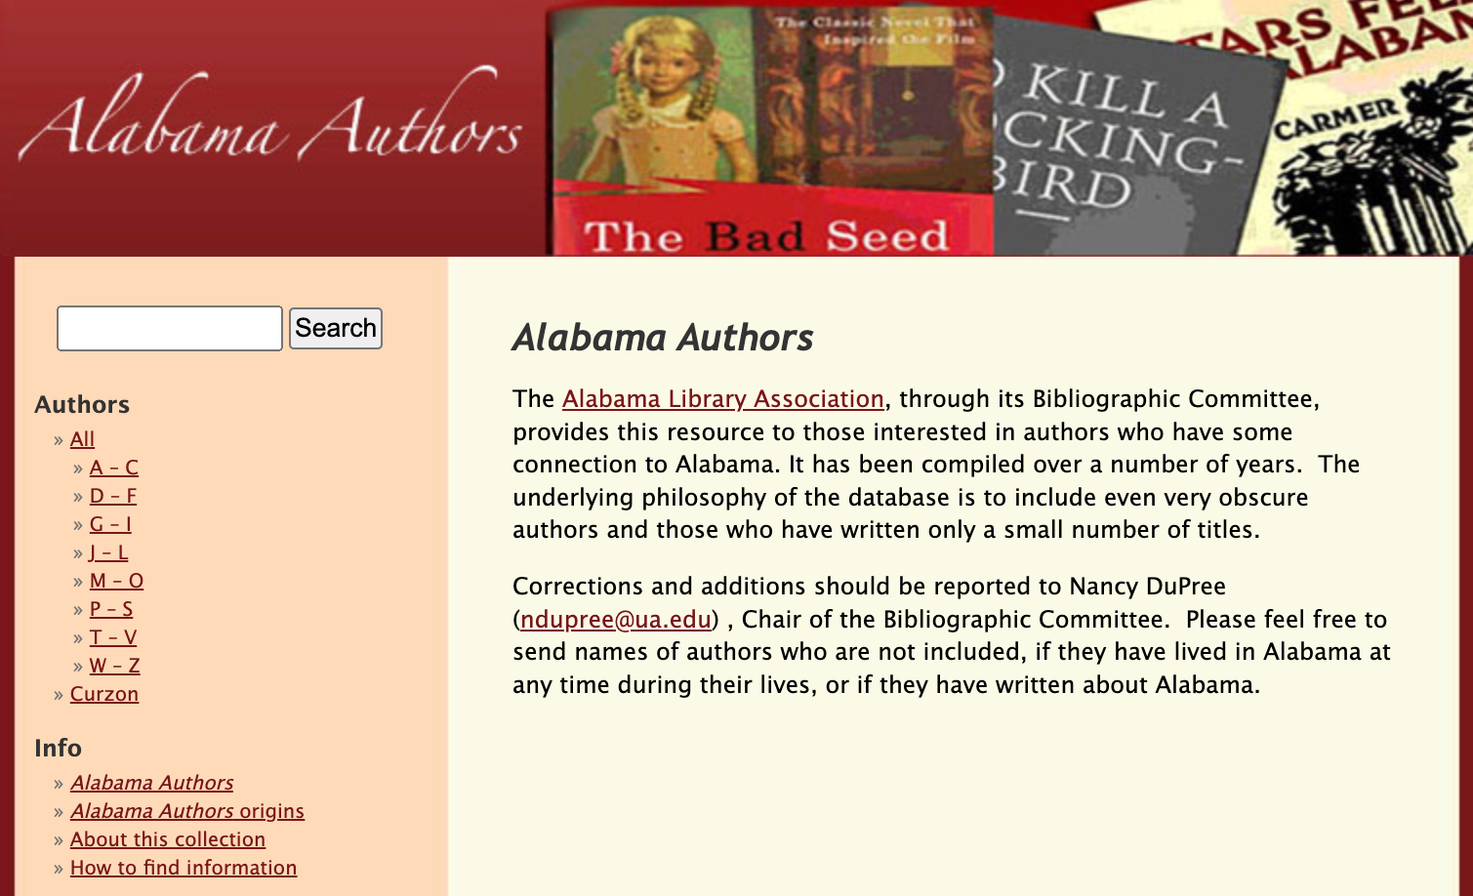
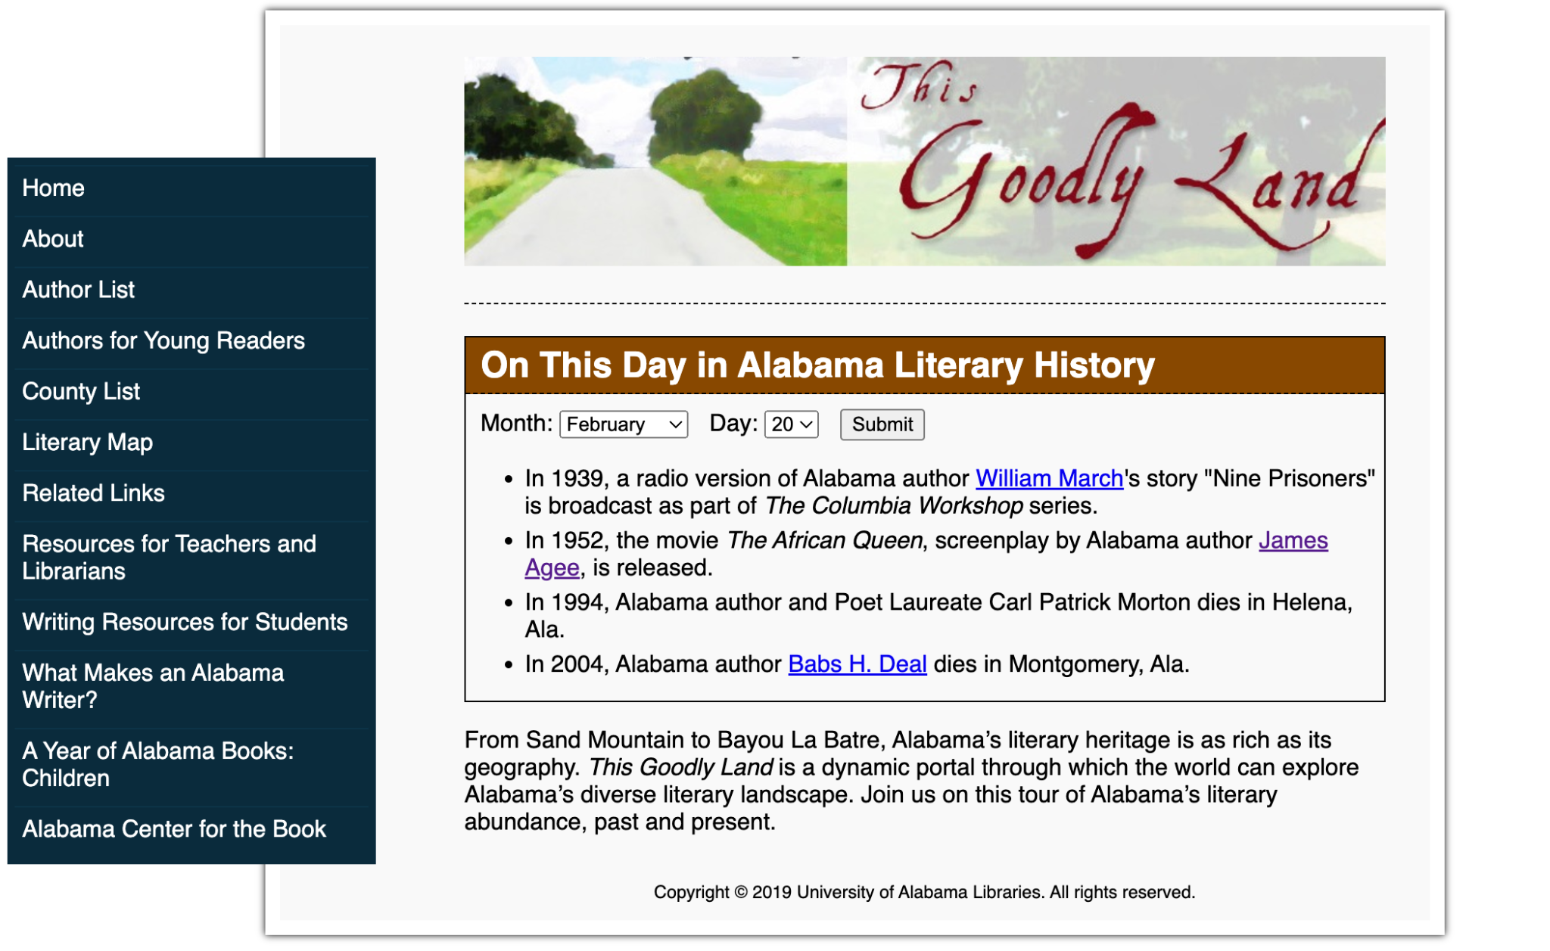
Lessons Learned
Amee Kivette
Performing usability analysis on multiple similar websites:
Guides the team’s understanding of the user experience
Reinforces ideas surrounding resource accessibility and consistency of users’ experiences
University of Alabama, Alabama Authors website
The Goodly Land website

Slide 34
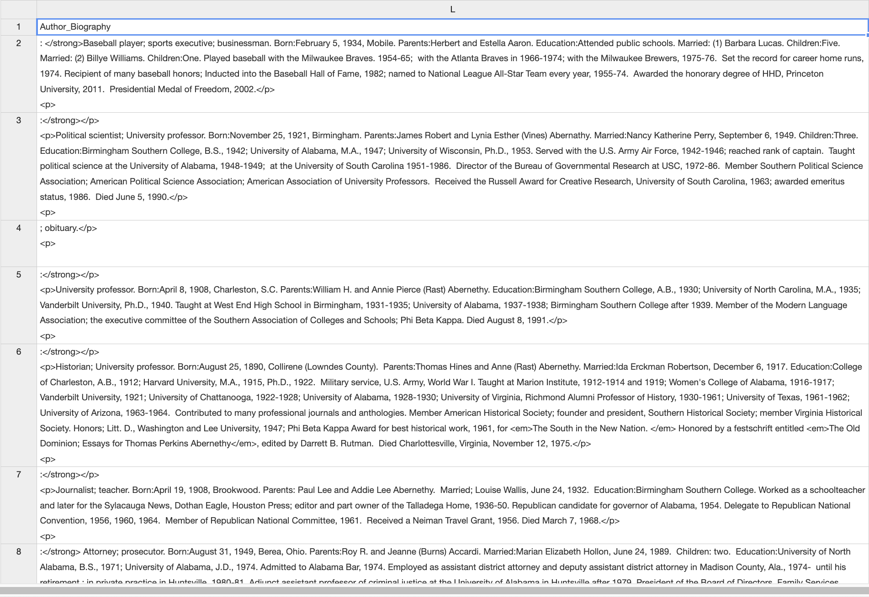
Current Plans
Keanna Tennyson
Obtain sponsor feedback for the preferred solution
Neatline plugin in Omeka
D3.js GitHub hosting embedding
Analyze the viability of data-related user stories
Can we add in author birth dates by scraping information from biography fields?
Author data biography field entries

Slide 35
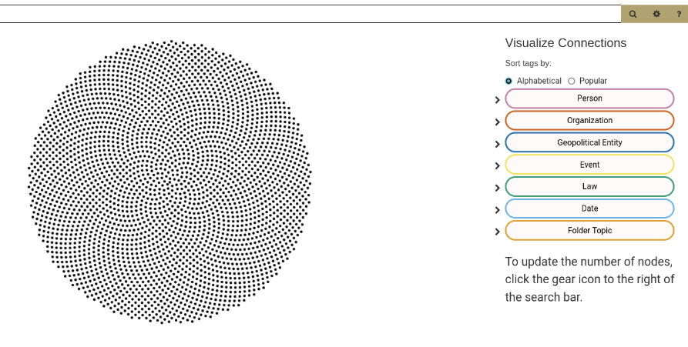
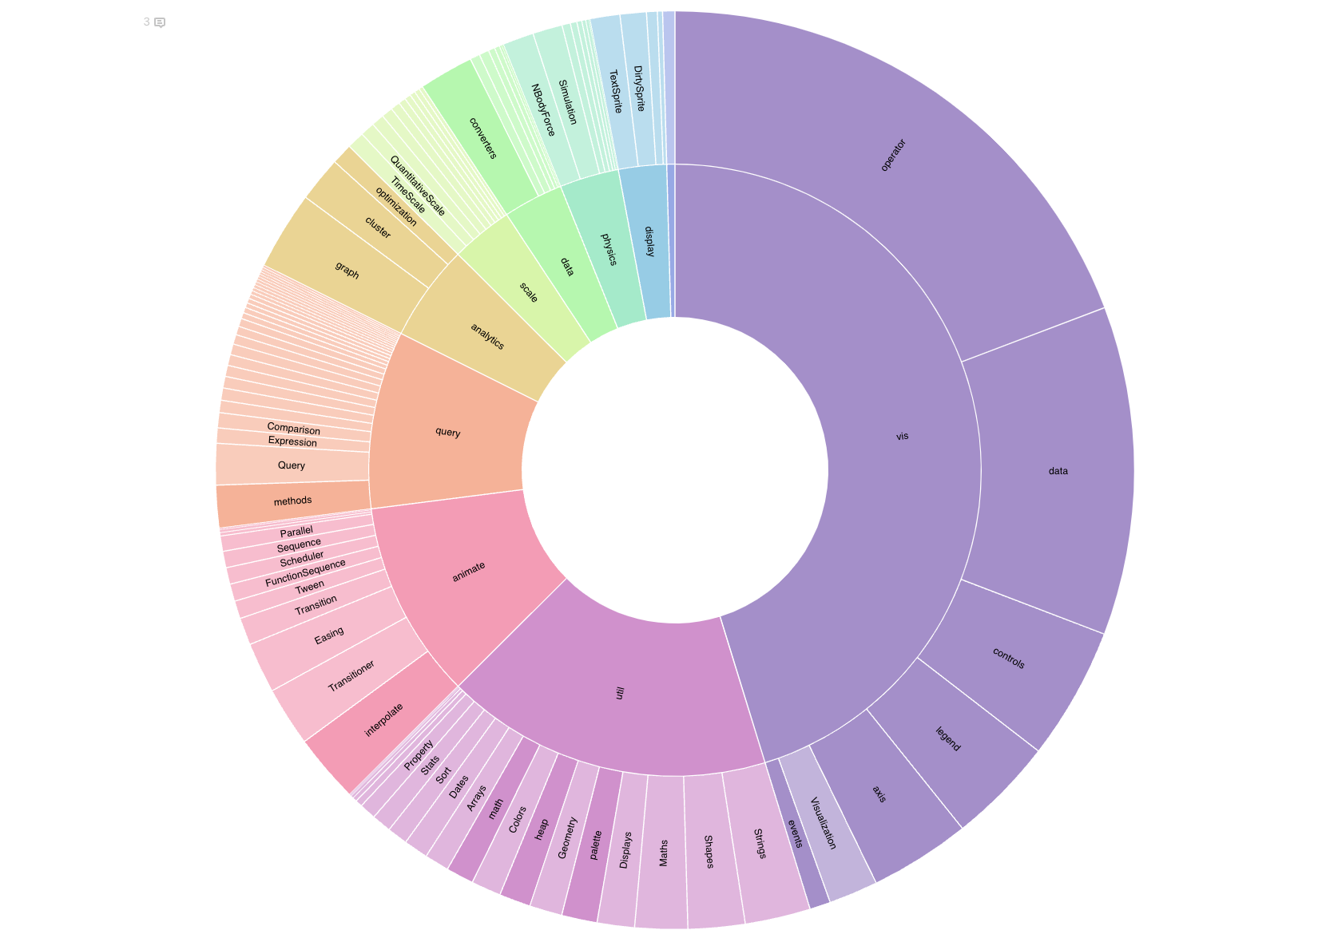
Future Plans
Keanna Tennyson
Add additional data visualizations
Graph visualization plugins on Omeka Classic
External sunburst drill-downs
Conduct usability reviews to validate accessibility requirements
Web Content Accessibility Guidelines (WCAG)
Archiviz plugin on Omeka Classic
D3.js zoomable sunburst

Slide 36
Demo
https://cadypridgeon.github.io/al-authors-chronology/

Slide 37
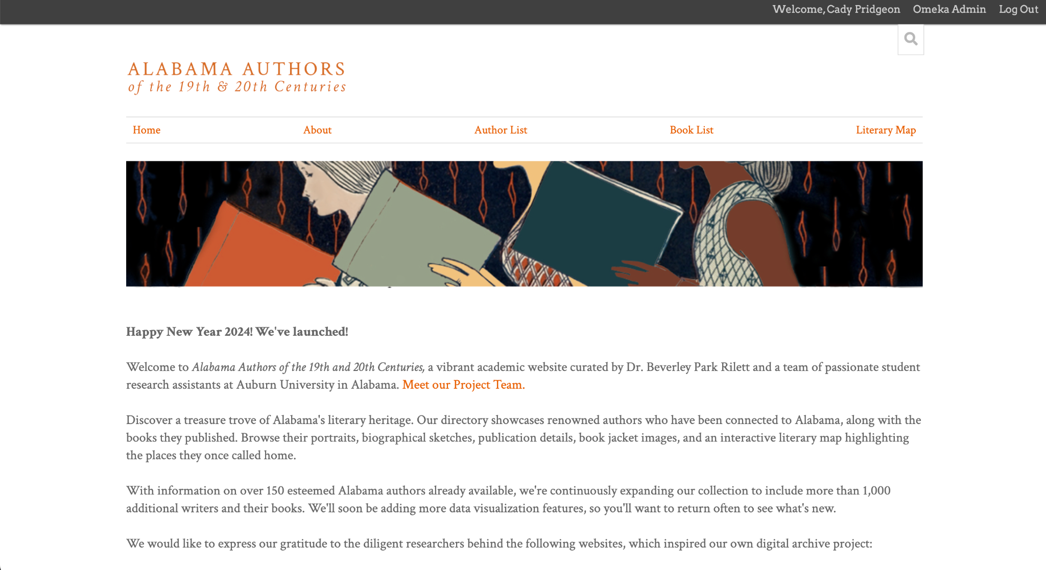
Thank you!
Questions?

